Slide 1

Learn Production Grade React-Redux JS
By Gautam Kumar(Soe Win)

Slide 2
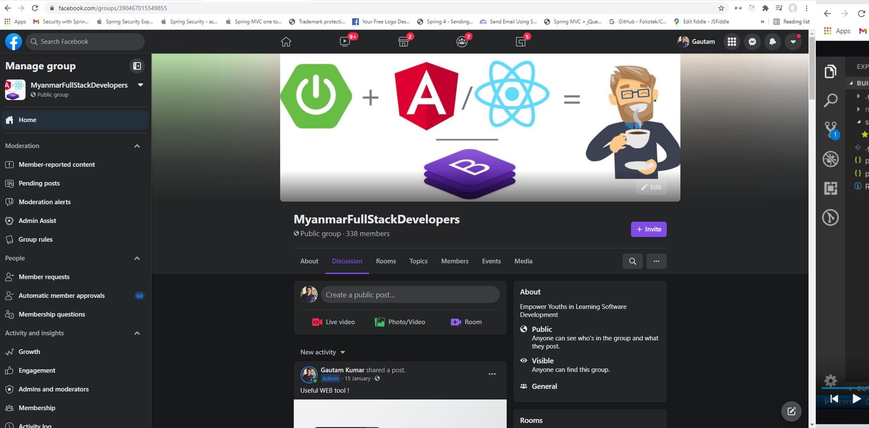
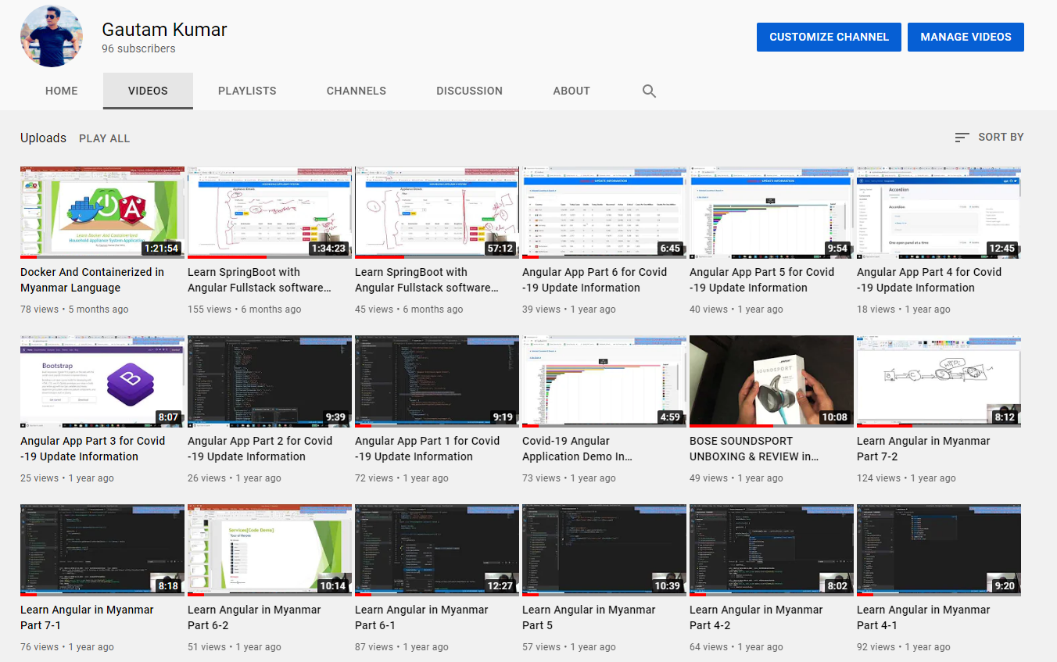

Slide 3
Can you build something big, complicated, interactive, and testable with it?

Slide 4
Contents
React Component Approaches
Initial App Structure
Redux Intro
Actions, Store and Reduce
Connecting React to Redux
Redux Flow
Async Writes in Redux
Async Status & Error Handling
Testing React
Testing Redux
Production Build
Conclusion

Slide 5
React Component Approaches
createClass Component
var HelloWorld = React.createClass({
render: function () {
return (<h1>Hello World</h>)}
});
// Not Modern JS Approach
Class Component
import React, {Component} from 'react';
class HelloWorld extends React.Component{
constructor(props) {
super(props);
}
render() {
return (
<h1>Hello World</h1>
)
}
}// Not Modern JS Approach, Modern JS already provide class built-in
Function Component
import React from 'react';
function helloWorld(props) {
return (
<h1>Hello World</h1>
)
}
Arrow Function Component
const helloWorld = () =>
<h1>Hello World</h1>;
// Modern JS

Slide 6
Cont’d
Benefits of Functional Component
Easier to understand
Avoid annoying `this` keyword and binding
Less code transpile compare with Class Component(check here => https://babeljs.io/repl/)
Enhance code completion / intellisense
Easy to test as they are just Functions only
Performance enhanced due to supportive in React v16
Class may be removed together in future due to React Hooks are taking places

Slide 7
Cont’d
When to use Class Component and Functional Component
Before React v16
Class Component
State
Refs
Lifecycle methods
After React v16
Functional Component
useState
useEffect
useContext
Additional Hooks
useReducer
useCallback
useMemo
useRef
useImperativeHandle
useLayoutEffect
useDebugValue
Not supported After v16
ComponentDidError
getSnapshoBeforeUpdate

Slide 8


Slide 9
Initial App Structure
Create React App
Create Home Page
Create About Page
Create Course Page
Configure App Entry Point
Create App Layout
Create Header
Create 404 Page

Slide 11
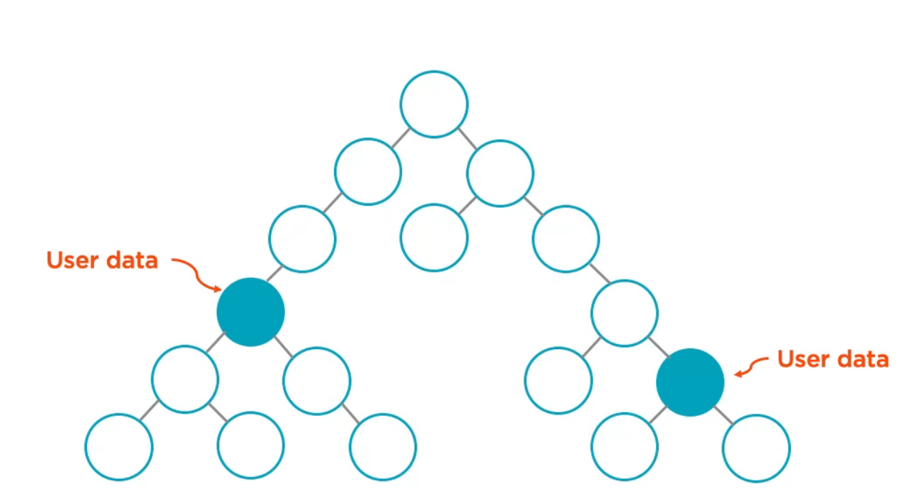
Redux Intro (Why I need Redux?)
3 Solutions to Solve above problem

Slide 12
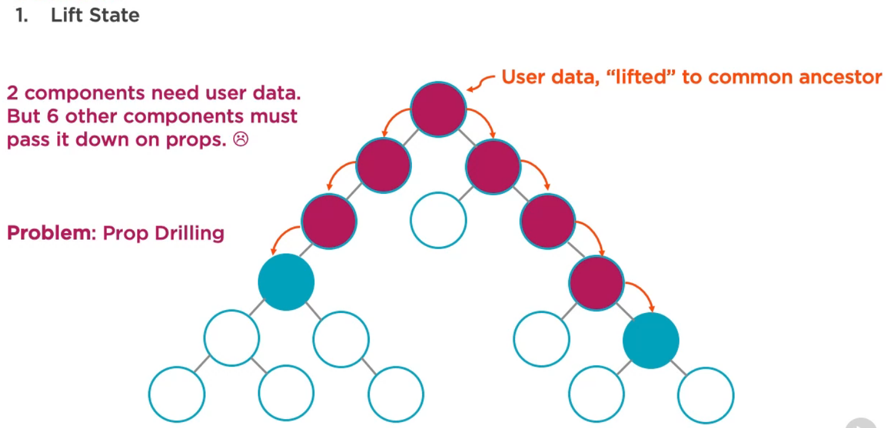
Cont’d

Slide 13
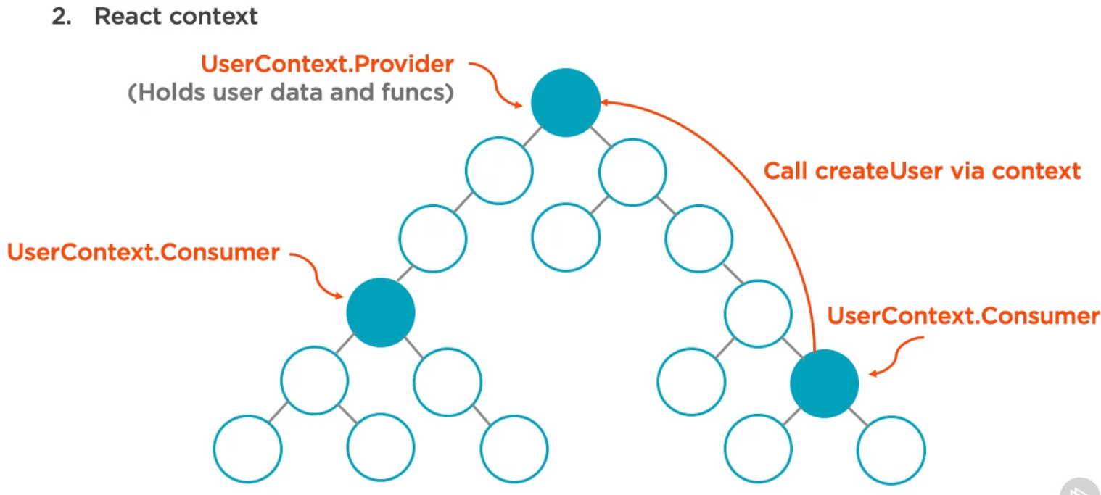
Cont’d

Slide 14
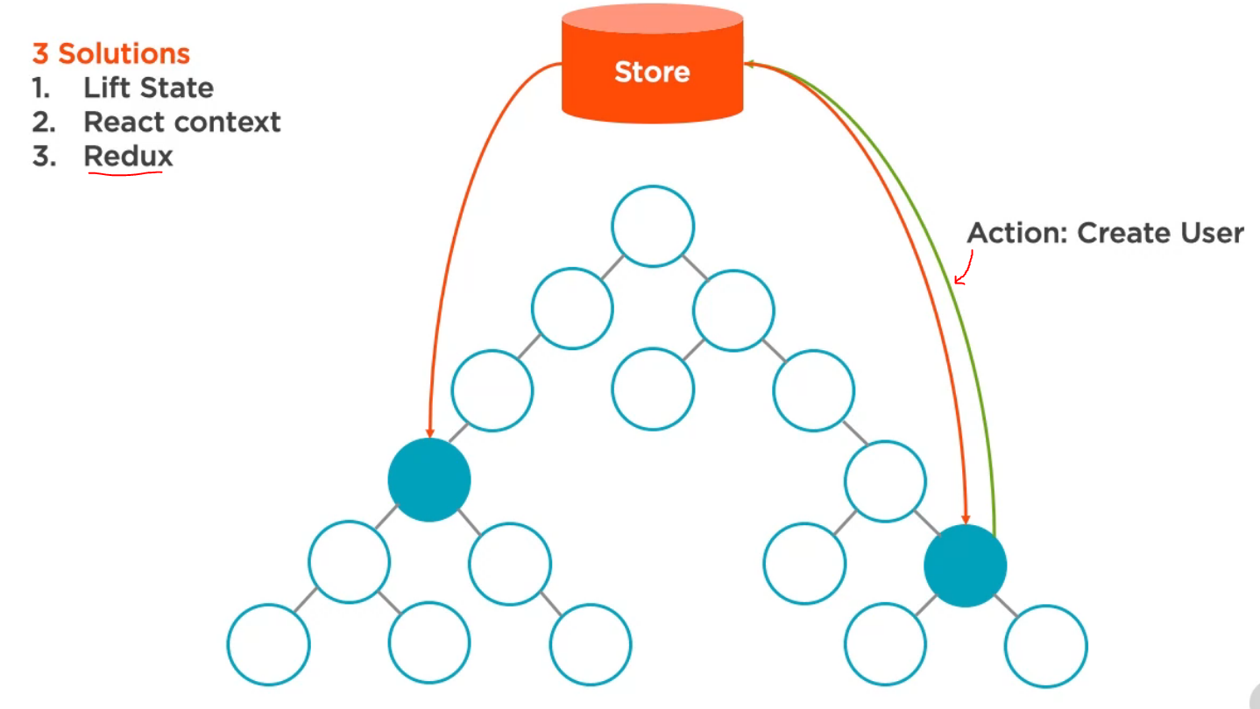
Cont’d
Update User Data
Refresh Data
Refresh Data

Slide 15
Cont’d
When Redux is Helpful!
Complex Data
Inter-component communication
Non-hierarchical data
Need many actions(write, read, delete data)
Same data used in many places
“… If you aren’t sure if you need it, you don’t need it”
~Pete Hunt

Slide 16
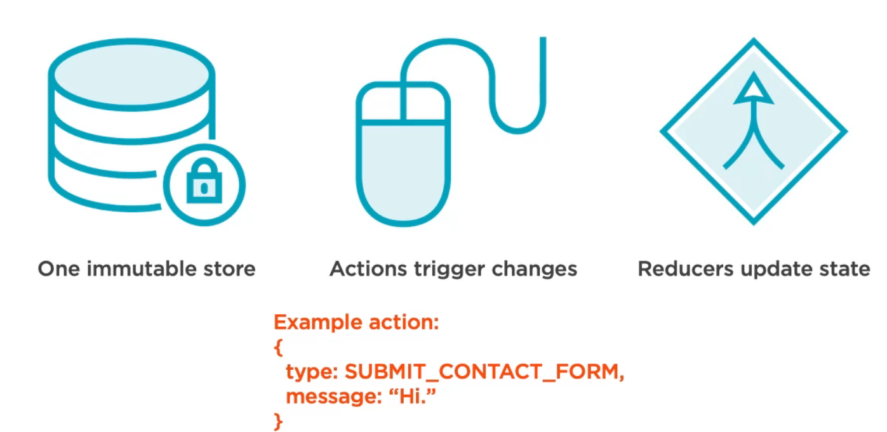
Cont’d
3 - Simple Principle of Redux

Slide 17
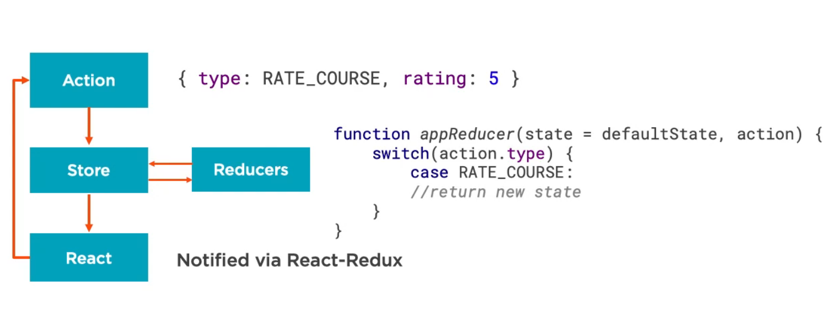
Cont’d
Redux Overview

Slide 19
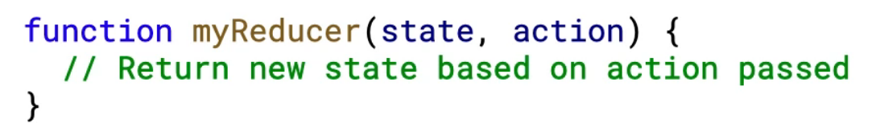
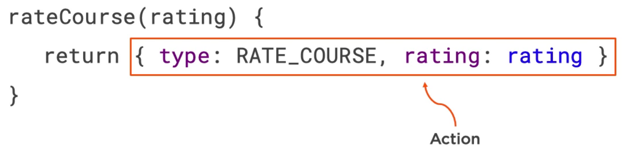
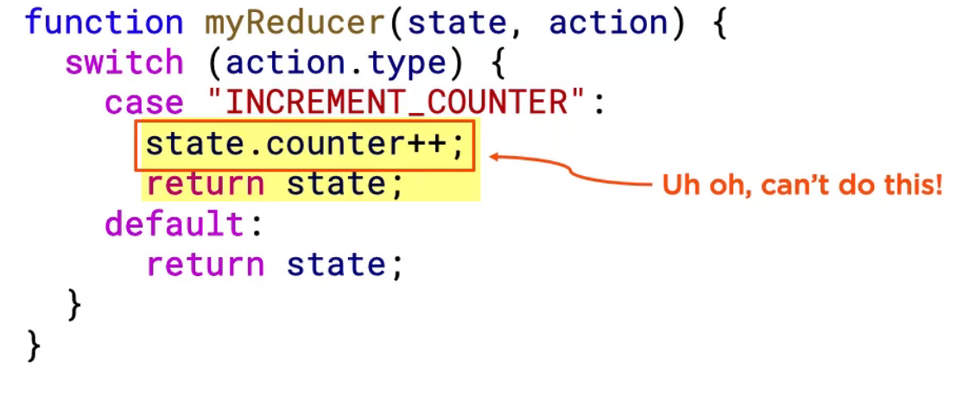
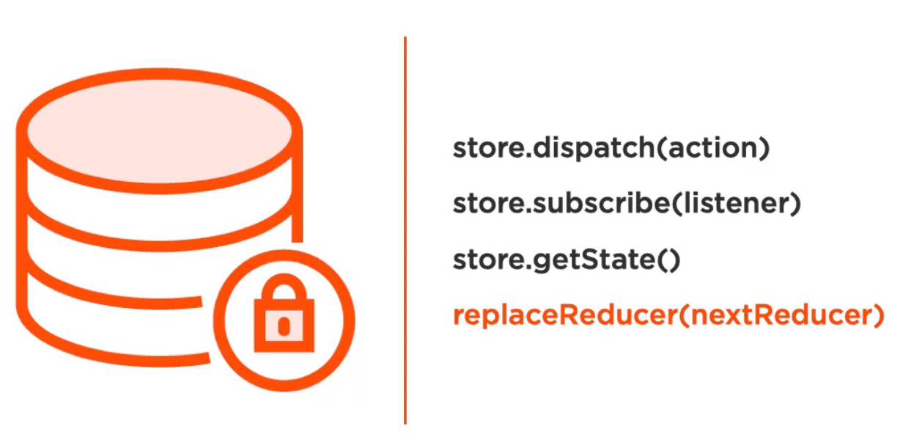
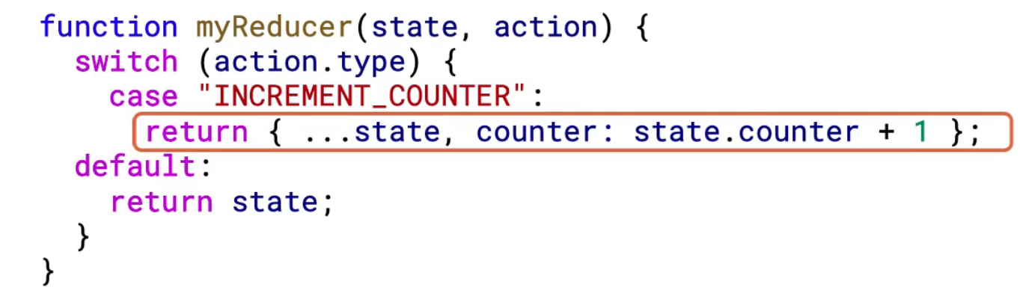
Actions, Store and Reduce
Actions
Reducers
Can’t return mutable Object
Store
Keep central source of truth data
Listen Dispatch to handle actions
Work with Reducer to update the data
Maintain Immutability
OK, return immutable Object

Slide 20
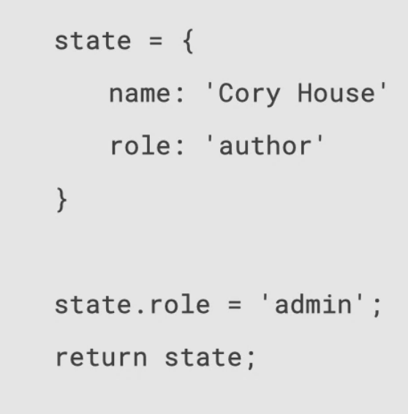
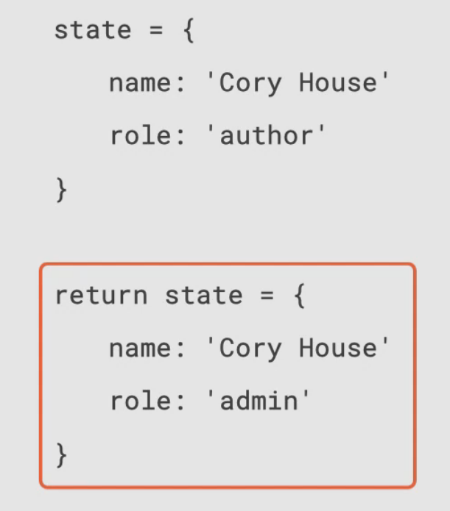
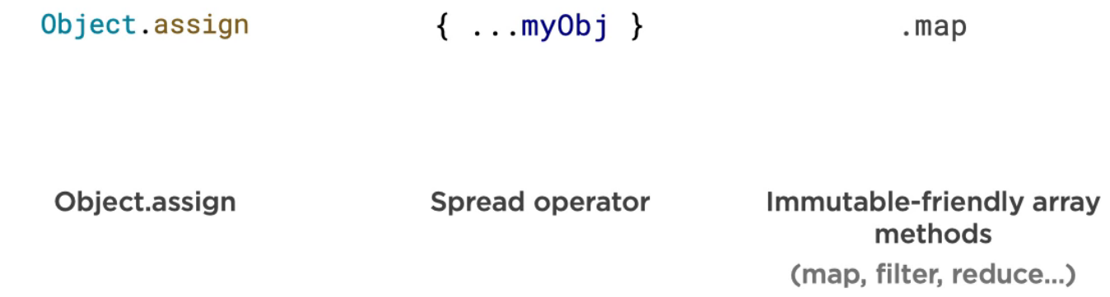
What is Immutability ?
Instead of changing state Object, return a new Object
Mutable
Objects
Functions
Arrays
Mutable Example
Immutable Example
Immutable Already
Number
String
Boolean
Undefined
Null
Return a new Copy each time value changed
Multiple Ways to Get this done by using below methods!

Slide 21
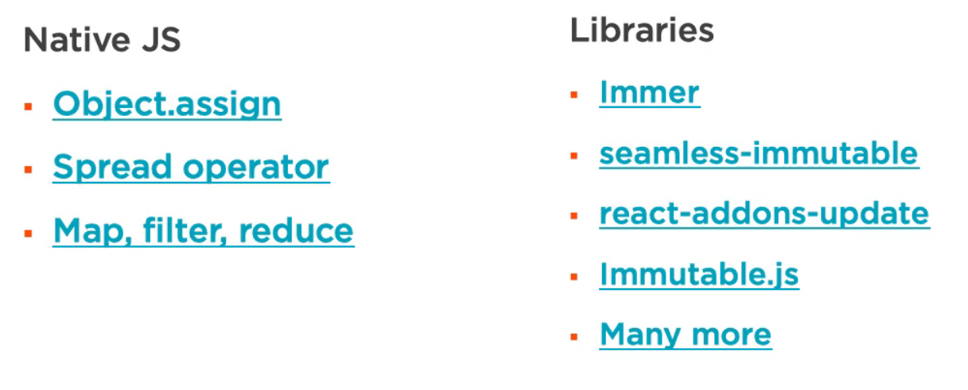
Cont’d
Native JS Vs Powerful Libraries

Slide 23
Connecting React to Redux
How do I connect React with Redux?
We will see difference between Container vs Presentation Component
React-Redux
Provider
Connect

Slide 24
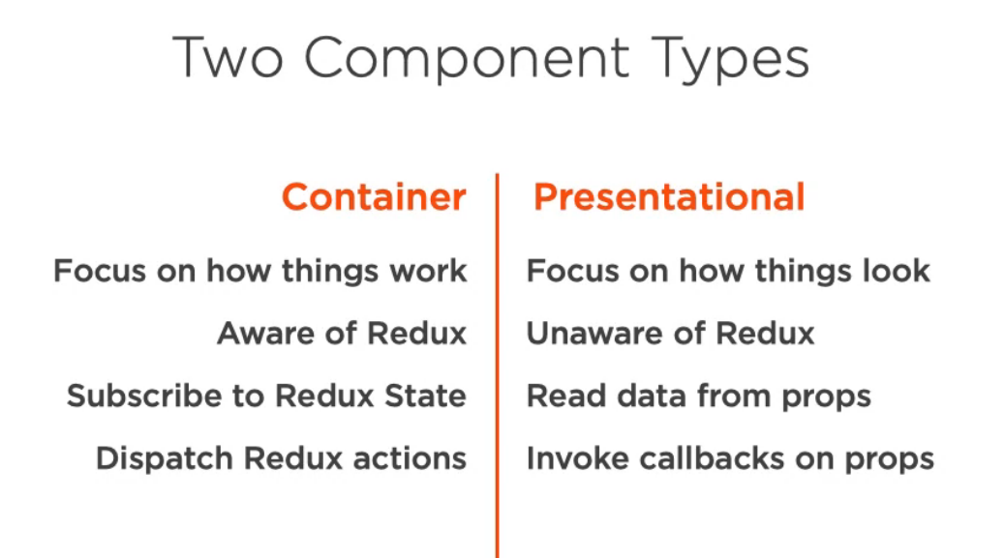
Cont’d

Slide 25
Cont’d
Note: In Redux container, data is called`state`, and when it goes to Presentational Layer(Component) then it becomes `props`.

Slide 26
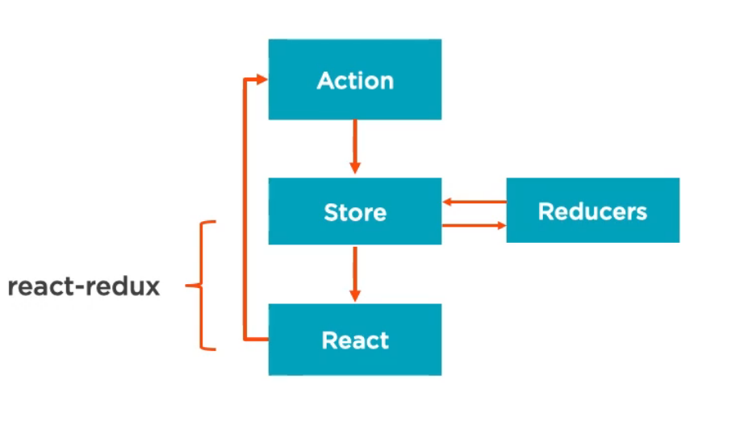
Connecting React to Redux
Cont’d
You can use Redux with
Angular-Redux
Vue-Redux
Vanila-Redux
React-Redux

Slide 27
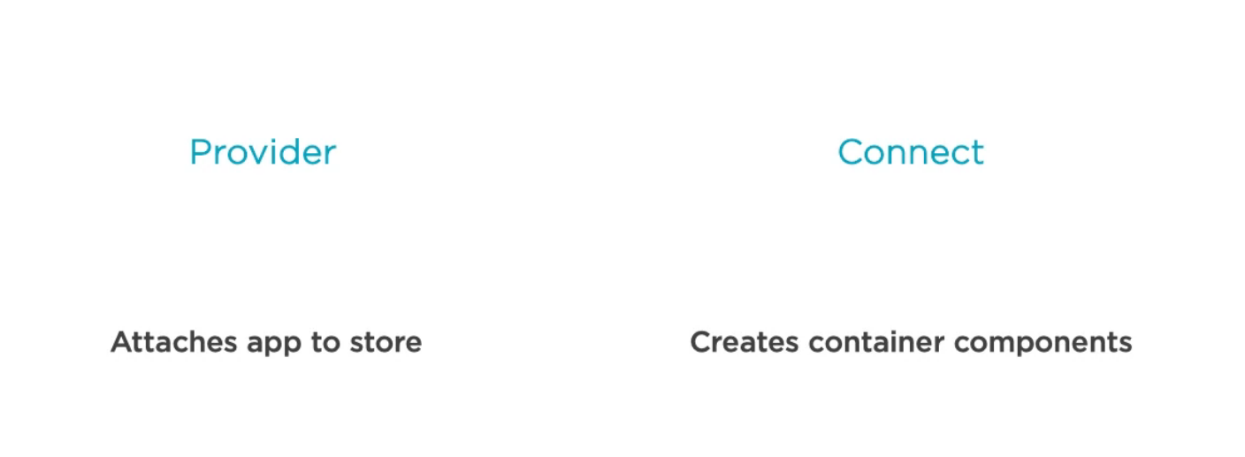
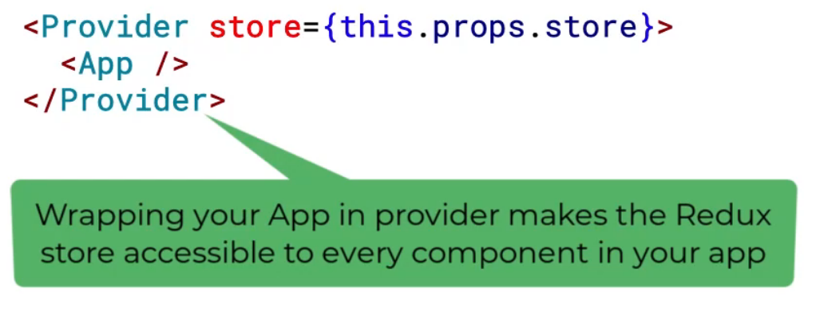
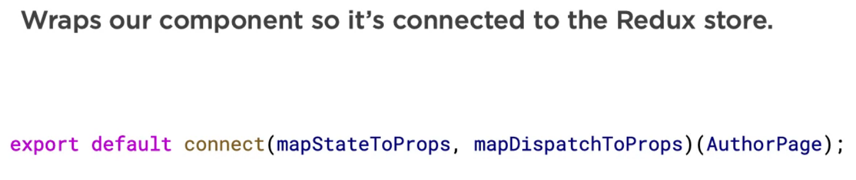
React-Redux
Cont’d

Slide 28

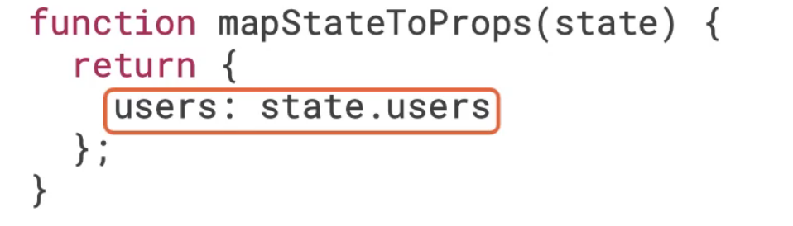
React-Redux Connect
Cont’d
Every time a component is updated, it calls the mapStateToProps We will use RESELECT lib for memoization so that it will on focus on updated object data without checking whole object to avoid expensive operation.
Memoization is like caching the function calls, RESELECT will check it is just called with previous parameters, if that is called then it just return memized value.

Slide 29
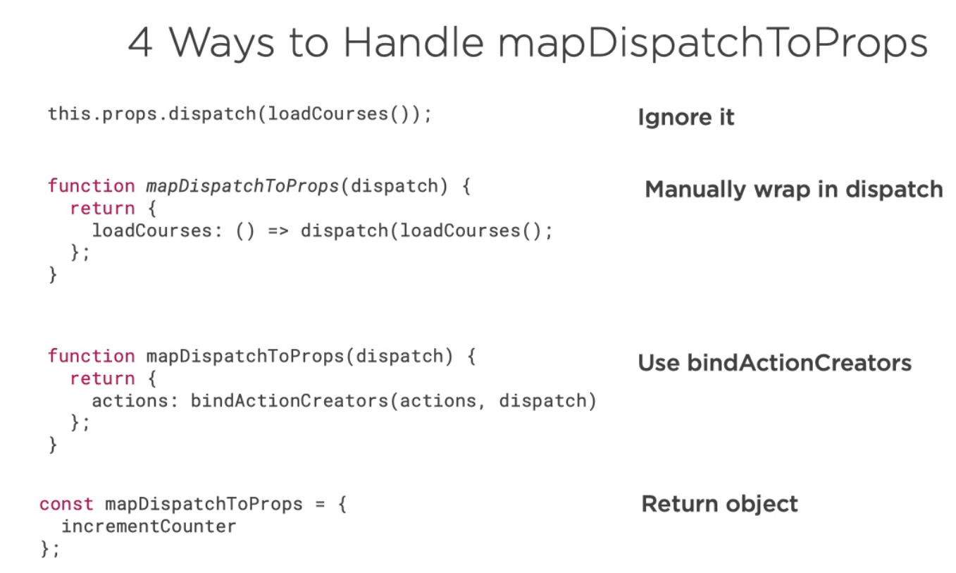
Cont’d
// In component this.props.loadCourses();
In Redux dispatch there is already loadCourses();
// In component this.props.incrementCounter()
Wrapped Automatically

Slide 31
Redux Flow
Create Course Form
Binding in Class
Create Course Action
Create Course Reducer and Root Reducer
Create Store
Initiate Store & Provider
Connect Container Component
Redux & DevTool
MapDispatchToProps
Manual mapping
BindActionCreator
Object Form
Action Type Constant

Slide 33
Async Writes in Redux
Mock API Setup
Middleware & Async Library
Thunk Introduction
Remove Inline Manage Course
Add First Thunk
Handle Loading Courses in React
Dispatch Actions on Load
Create CourseList
Practice Redux Flow – Load & Display Author Data
Centralize Initial Redux State

Slide 34
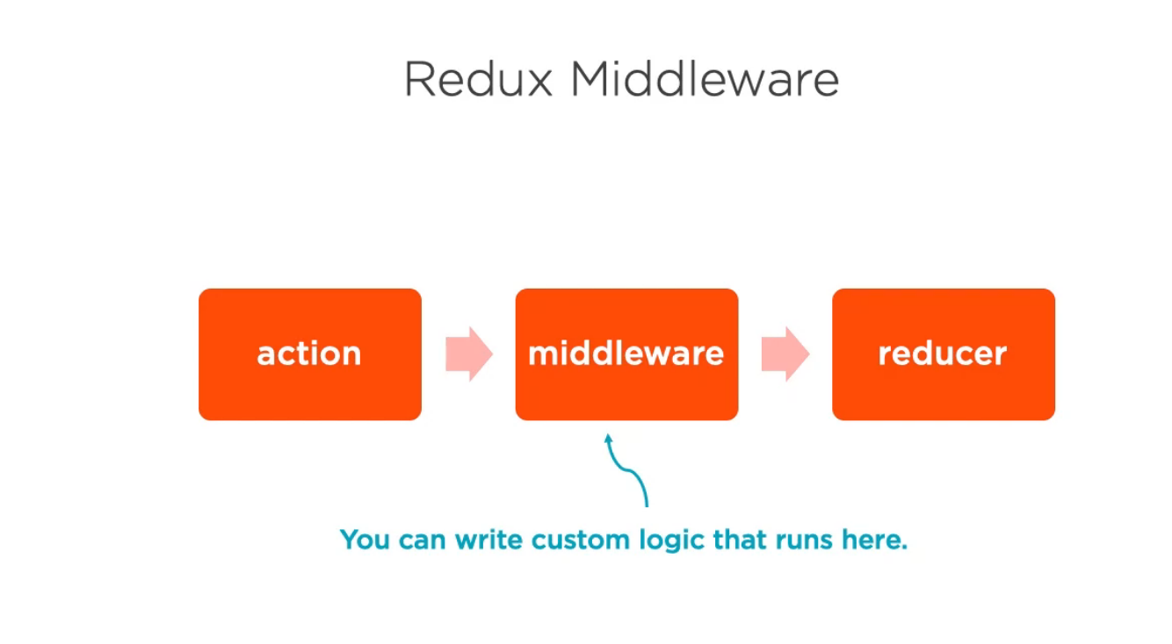
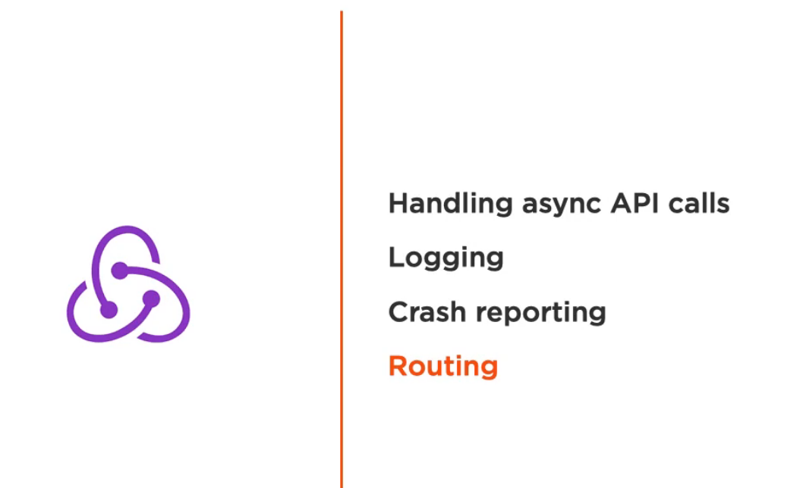
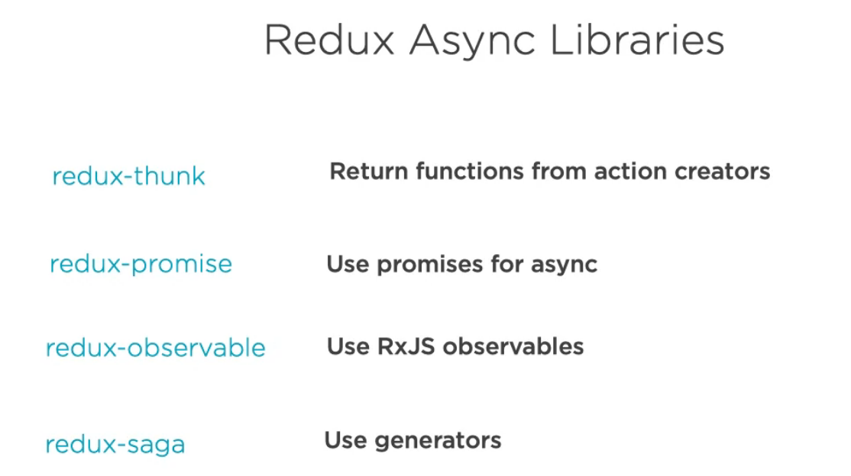
Cont’d
Middleware & Async Library

Slide 35
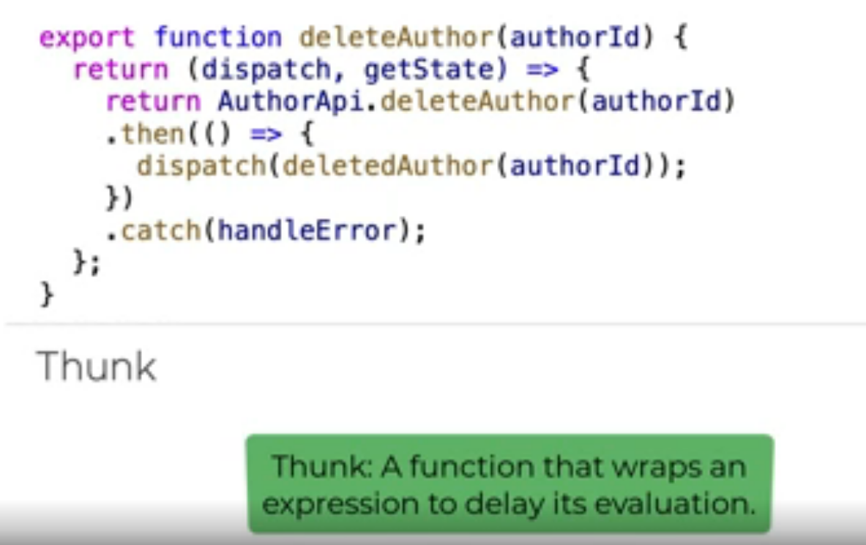
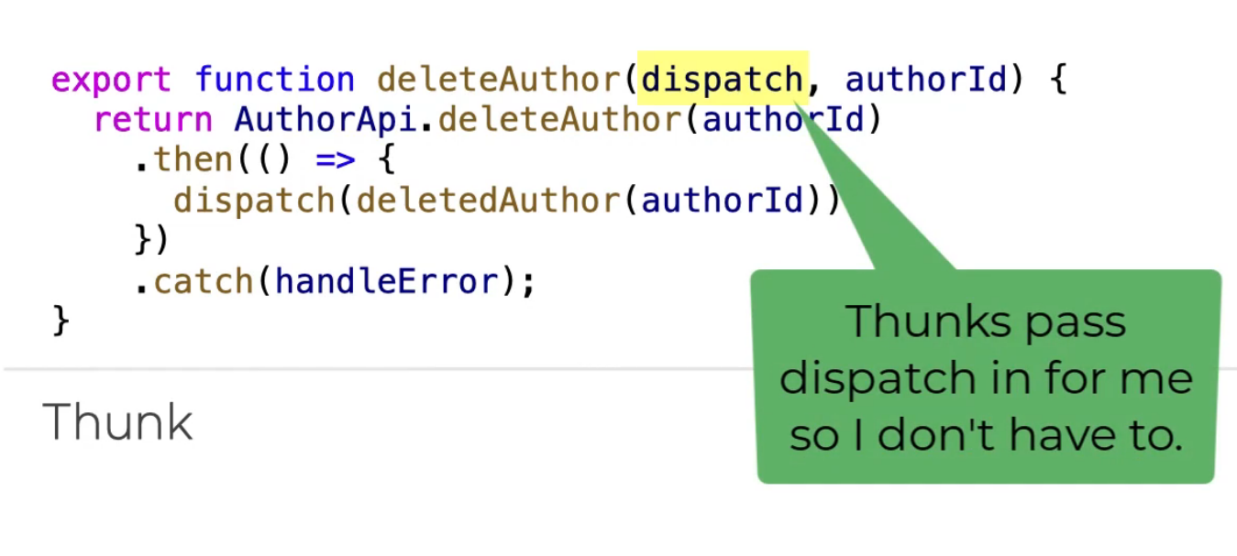
Cont’d
Thunk Introduciton
With Thunk
Without Thunk

Slide 37
Cont’d
Create Manage Course Page
Configure Routing for Manage Course
Convert Class Component to React Hooks
Create Course Form
Create Reusable Component (TextInput, SelectInput …)
Call CourseForm on ManageCourse
Implement Centralized Change Handler
Add Save Course and Action Creators
Handle Creates & Update in Reducer
Dispatch Create & Update
Redirect via React Router Component
Redirect via React Router History

Slide 39
Async Status & Error Handling
Create Spinner Component
Create API Status Actions
Call Begin API in Thunks
Add Spinner to CoursePages
Add Form Submission Loading Indicator
Handle Server-side Validation
Implement Client-Side Validation
Optimistic Delete
Async/Await

Slide 40
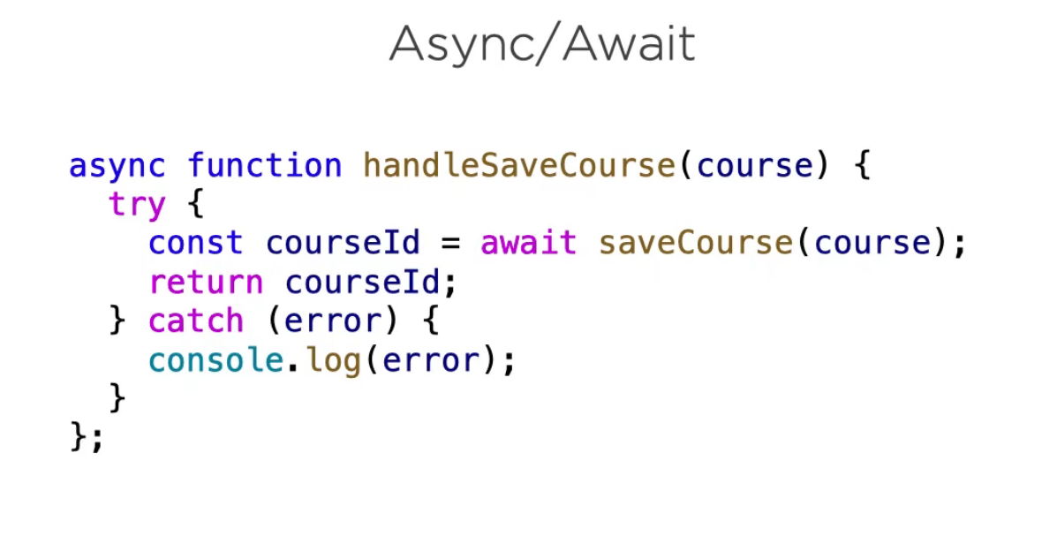
Cont’d
Async/Await

Slide 42
Testing React
Testing Technologies
Testing Frameworks
Helper Libraries
We’ll test React Components
Enzyme

Slide 43
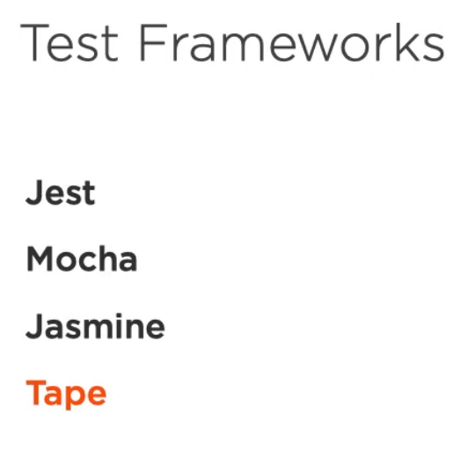
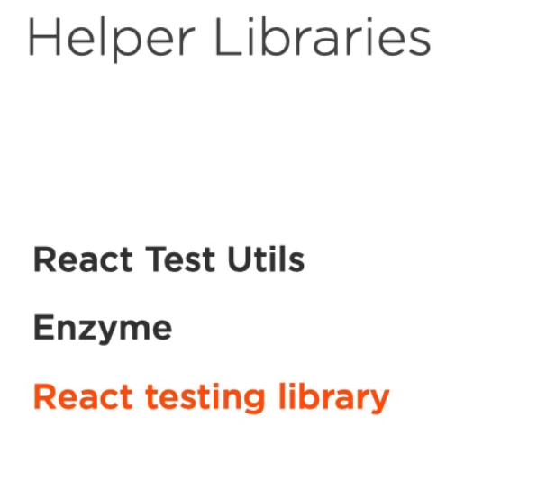
Cont’d
Testing Frameworks & Libraries
Comes with create-react-app
Also well-known and easy configurable
Specifically for React but Verbose API
Similar with Jest and Mocha but tedious to configure
Simple and less configurable, no global variable allow [ disadvantage over Jest, Mocha and Jasmine ]

Slide 44
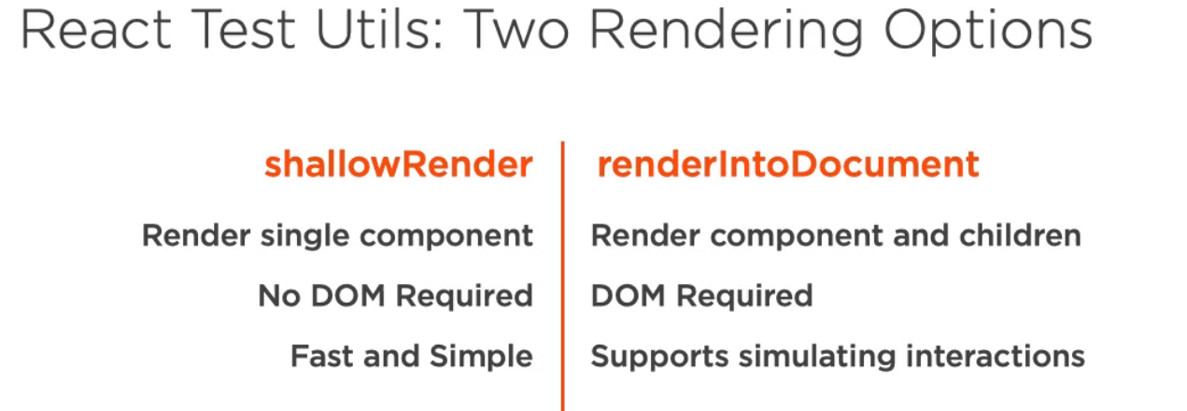
Cont’d

Slide 45
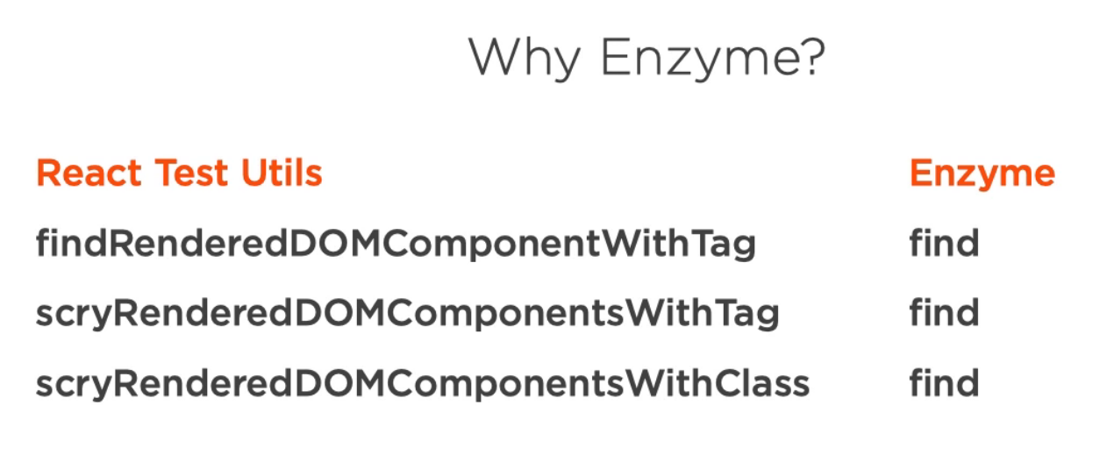
Cont’d
Clunky method names
React Test Utils running behind
Allow CSS selector also to test
Create JSDOM (In Memory DOM) to create virtual browser for testing same as React Test Utils
Also use Cheerio(Fast Jquery style selectors)
& many more
NOTE: Enzyme is Abstraction of React Test Utils

Slide 47
Testing Redux
Testing Connected Components
Testing Action Creators
Testing Thunks
Testing Reducers
Testing the Store

Slide 48
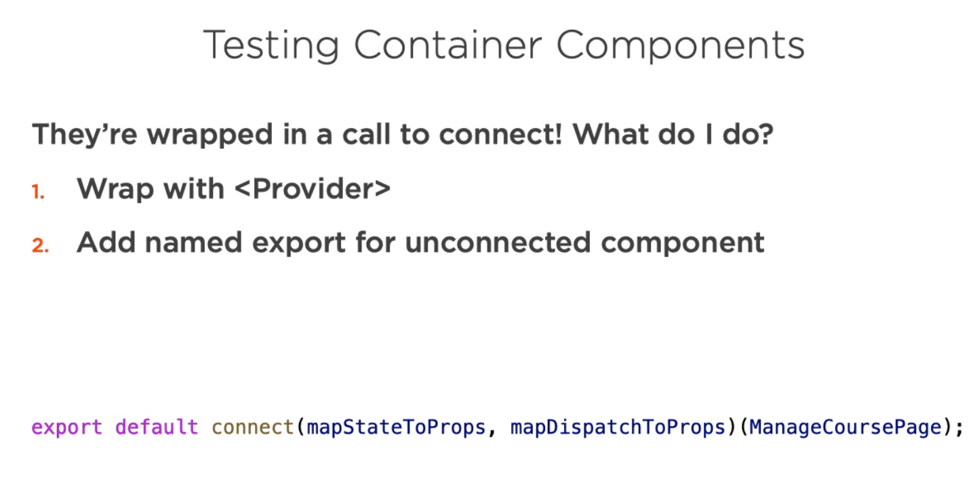
Testing Redux
Testing Connected Components

Slide 49
We Will Test
We Will Test
We Will Test connect

Slide 51
PRODUCTION BUILD

Slide 52
Conclusion!!!
https://www.facebook.com/groups/390467015549855
https://www.youtube.com/channel/UCdLKiOx6aWZZkQvALP3LiDw

